Slide 1

DEPBOTS
Presented by : Vipul Gupta Paridhi Gusain
IT- EVENING ECE-1 Morning
(20296303122) (36015002822)

Slide 2
INTRODUCTION
In the 21st century, mental illness has surged, leading to the development of various methods for treatment.
The primary challenge remains accurately detecting whether an individual is truly suffering from a mental health condition.
Leveraging technology to address this issue can significantly enhance the diagnosis and management of mental illnesses like depression.
AI and machine learning algorithms can analyse patterns in speech, text, and behaviour to identify signs of depression and other mental health issues. These technologies can process large datasets, identifying subtle indicators that might be missed by human observation.

Slide 3
PROBLEM STATEMENT
DETECT DEPRESSION FROM A PERSON'S TWEETS

Slide 4
APPROACH AND METHODOLOGY
APPROACH
Importing important libraries and the ‘Sentiment 140’ dataset.
Preprocessing the data using the nltk library to remove all the unwanted text and literals.
Creating the tokens from the data text and padding the data for a systematic organization of the data.
Forming a training and testing split from the data.
Creation of an RNN model using keras library.
Training and evaluating the model to increase its accuracy.
Getting input tweets from the user.
After preprocessing the input tweets, prediction of whether the tweet is depressed or not.

Slide 5
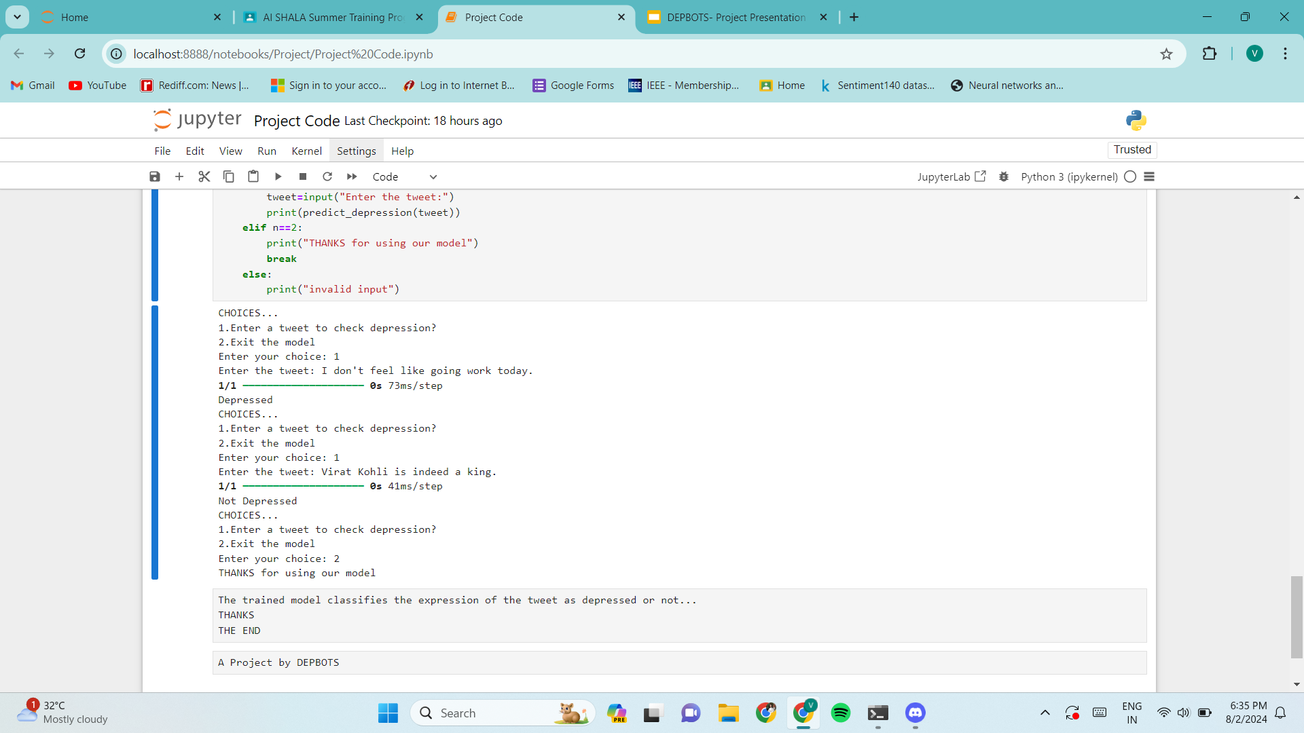
RESULT
The Model is able to classify the tweets whether they are depressed or not.

Slide 6
CONCLUSION
Successful detection of an individual's mental illness such as depression through their behavioural patterns and their tweets.
Hence, We have successfully trained our model to detect depression with the help of RNN and Deep Learning Model.

Slide 7
REFERENCES
Dataset by Kaggle https://www.kaggle.com/datasets/kazanova/sentiment140?resource=download&select=training.1600000.processed.noemoticon.csv
StackOverflow - Referred for solving some minor errors

